Slide 1


Three real-world operational research problems and their underlying graph properties.
Rhyd Lewis
School of Mathematics, Cardiff University, LewisR9@cf.ac.uk.
www.RhydLewis.eu
Notes:
In this talk I will introduce three original and real-world combinatorial optimisation problems, together with algorithms that exploit their underlying graph-theoretic properties. The first problem makes use of Eulerian cycles to help arrange trapezoids into sequences so that the space between successive shapes in minimised. The second problem concerns the design of seating plans for large parties, using ideas from the graph colouring problem. Finally, the third problem uses notions from vehicle routing, set covering, and bin packing to help produce cost effective school transport systems.

Slide 2
The Bin Packing Problem
In a standard 1D bin packing problem we seek to pack 1D items into a minimum number of fixed-sized bins.
It is NP-complete.
For this problem, the order and orientation of items within each group irrelevant
But what if it is?

Slide 3
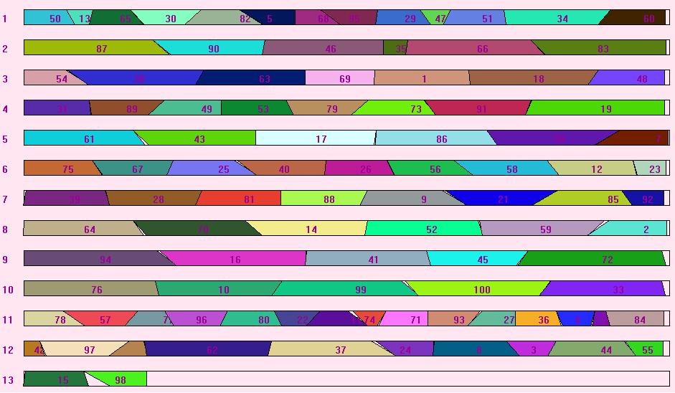
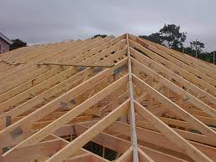
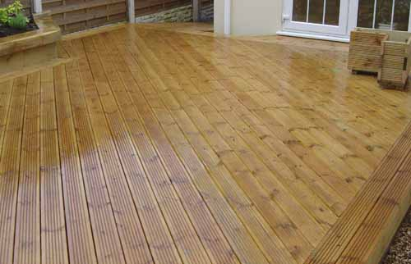
PROBLEM 1: Trapezoid Packing
Problem:
Arrange a set of trapezoidal items into a minimal number of bins
Issues
Which items should be put into the same bin?
How should these items be arranged in a bin?
Lewis, R. and P. Holborn (2017) 'How to Pack Trapezoids: Exact and Evolutionary Algorithms'. IEEE Transactions on Evolutionary Computation, vol. 21(3), pp. 463-476.
Lewis, R., X. Song, K. Dowsland, and J. Thompson (2011) 'An Investigation into two Bin Packing Problems with Ordering and Orientation Implications'. European Journal of Operational Research, vol. 213, pp. 52-65.
Notes:
I mentioned Eulerian Cycles a minute ago. They come in here too

Slide 4
Arranging the trapezoids in a single bin
q_{j}
…
i
j
H
p_{i}
q_{i}
p_{j}
W
Items have 4 orientations, but we only need to consider two
Inter-item wastage in the above is simply |q_{i} – q_{j}|
Wastage w = all inter-item wastage plus the LHS and RHS
Problem Def: Given a group of items S such that:
can we determine an item arrangement such that:
Total area of trapezoids in the group
Area of the bin
Total area of trapezoids in the group plus inter-item wastage

Slide 5




TSP interpretation
Arranging trapezoids in a single bin is a special type of TSP
Each projection is a “city” ; edges between cities correspond to wastage; and edges on the same shape are set to minus infinity
Can a “valid” route of less than w be achieved (discounting minus infinity arcs)?
$$−∞$$
$$−∞$$
$$−∞$$
$$−∞$$

Slide 6
How to Solve the Problem
Take a set of trapezoids
Form a multigraph G using projection pairs as edges
E = {{0,0},{0,1},{0,2},{1,5},{2,4},{4,6},{5,6}}
0 0 0 1 0 2 1 5 2 4 4 6 5 6
0
1
2
3
4
5
6

Slide 7
How to Solve the Problem
Take a set of trapezoids
Form a multigraph G using projection pairs as edges
E = {{0,0},{0,1},{0,2},{1,5},{2,4},{4,6},{5,6}}
Fact: If G is Eulerian and connected, then a zero cost arrangement exists.
This is the case here: ((0,0),(0,1),(1,5),(5,6),(6,4),(4,2),(2,0))
0 0 0 1 0 2 1 5 2 4 4 6 5 6
0
1
2
3
4
5
6

Slide 8
How to Solve the Problem
Fact. If G is not Eulerian, then a minimum weight matching can be introduced on the odd-degree vertices to make it Eulerian.
For example,
0
1
2
3
4
5
6

Slide 9
How to Solve the Problem
Fact. If G is not Eulerian, then a minimum weight matching can be introduced on the odd-degree vertices to make it Eulerian.
For example,
If G is now connected, an optimal arrangement is an Eulerian cycle in this new graph as before
((0,0),(0,2),(2,4),(4,6),(6,4),(6,5),(5,1),(1,3),(1,0))
0
1
2
3
4
5
6
Wastage = 2
Wastage = 2
Wastage = 2
Wastage = 2

Slide 10
How to Solve the Problem
If G is Eulerian but disconnected, the components need to connected.
Fact. Each of the n Eulerian components is optimal.
Fact. Optimally joining two components gives us n – 1 optimal Eulerian components
1
2
3
4
5
6
7
8
9
10
11
12
13
14
15
w = 4
((1,1),(1,3),(3,5),(5,7),(7,6),(6,2),(2,1)) Wastage = 0
((8,8)) Wastage = 0
((9,9),(9,11),(11,13),(13,15),(15,13),(15,14),(14,10),(10,12),(10,9)) Wastage = 4

Slide 11
How to Solve the Problem
If G is Eulerian but disconnected, the components need to connected.
Fact. Each of the n Eulerian components is optimal.
Fact. Optimally joining two components gives us n – 1 optimal Eulerian components
1
2
3
4
5
6
7
8
9
10
11
12
13
14
15
w = 4
((1,1),(1,3),(3,5),(5,7),(7,6),(6,2),(2,1)) Wastage = 0
((8,8)) Wastage = 0
((9,9),(9,11),(11,13),(13,15),(15,13),(15,14),(14,10),(10,12),(10,9)) Wastage = 4

Slide 12
How to Solve the Problem
If G is Eulerian but disconnected, the components need to connected.
Fact. Each of the n Eulerian components is optimal.
Fact. Optimally joining two components gives us n – 1 optimal Eulerian components
1
2
3
4
5
6
7
8
9
10
11
12
13
14
15
w = 6
((1,1),(1,3),(3,5),(5,7),
(8,8)
,(7,6),(6,2),(2,1)) Wastage = 2
((9,9),(9,11),(11,13),(13,15),(15,13),(15,14),(14,10),(10,12),(10,9)) Wastage = 4

Slide 13
How to Solve the Problem
If G is Eulerian but disconnected, the components need to connected.
Fact. Each of the n Eulerian components is optimal.
Fact. Optimally joining two components gives us n – 1 optimal Eulerian components
1
2
3
4
5
6
7
8
9
10
11
12
13
14
15
w = 6
((1,1),(1,3),(3,5),(5,7),
(8,8)
,(7,6),(6,2),(2,1)) Wastage = 2
((9,9),(9,11),(11,13),(13,15),(15,13),(15,14),(14,10),(10,12),(10,9)) Wastage = 4

Slide 14
How to Solve the Problem
If G is Eulerian but disconnected, the components need to connected.
Fact. Each of the n Eulerian components is optimal.
Fact. Optimally joining two components gives us n – 1 optimal Eulerian components
1
2
3
4
5
6
7
8
9
10
11
12
13
14
15
w = 8
((1,1),(1,3),(3,5),(5,7),
(8,8)
(9,9),(9,11),(11,13),(13,15),(15,13),
(15,14),(14,10),(10,12),(10,9)
,(7,6),(6,2),(2,1)) Wastage = 8
A proof naturally follows which demonstrates this method to be exact. The problem using multiple bins is still NP-hard, however.
Notes:
Should note that this was only part of the papers I mentioned before. To tackle the multi-bin version we got excellent results by comining this algorithm with bin packing heuristics, grouping genetic algorithm and local search.

Slide 15
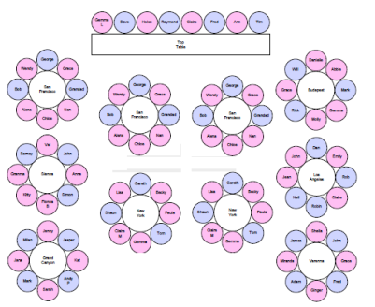
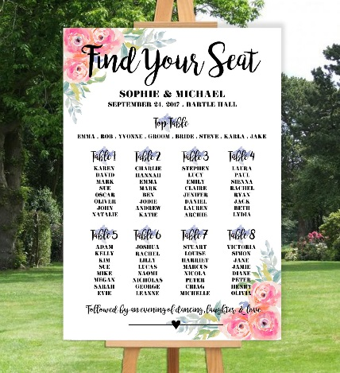
PROBLEM 2: Designing Seating Plans
Imagine a Wedding……
Sit families together
Keep adversaries apart
Tables are limited in size
www.weddingseatplanner.com
Lewis, R. and F. Carroll (2016) 'Creating Seating Plans: A Practical Application'. Journal of the Operational Research Society, vol. 67(11), pp. 1353-1362.
Carroll, F. and R. Lewis (2013) 'The "Engaged" Interaction: Important Considerations for the HCI Design and Development of a Web Application for Solving a Complex Combinatorial Optimization Problem'. World Journal of Computer Application and Technology, vol. 1(3), pp. 75-82.
Notes:
Some commercial tools that you have to pay for (basically moving things around the screen)
Need for speed in the online applications. Also compared to IP models in paper, but they were much slower.

Slide 16
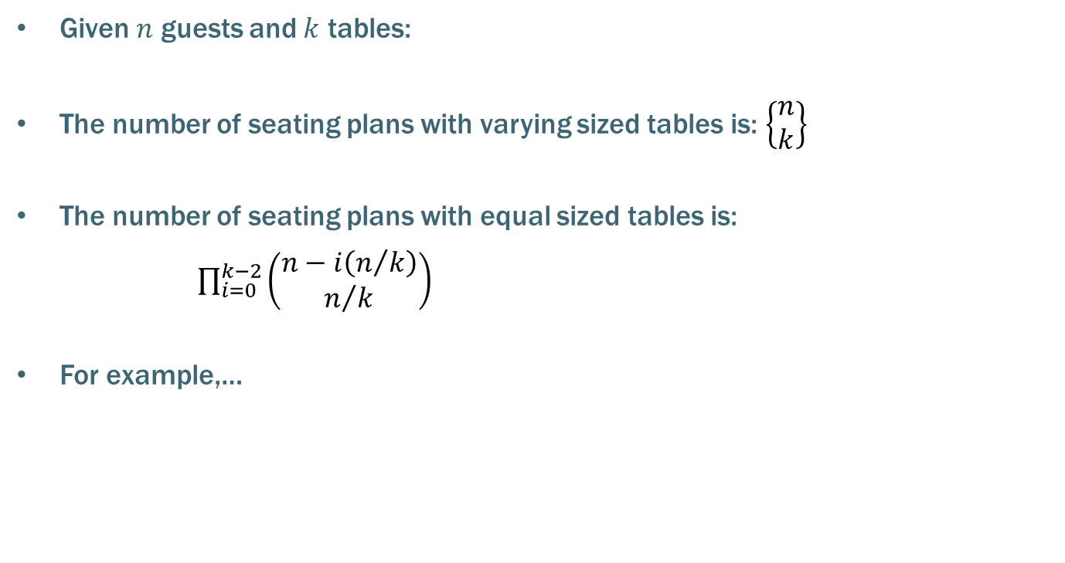
Solution Space
Given $n$ guests and $k$ tables:
The number of seating plans with varying sized tables is: $\left\{\begin{matrix}n \\ k\end{matrix}\right\}$
The number of seating plans with equal sized tables is:
$\prod_{i=0}^{k−2}{\left(\begin{matrix}n−i\left(n/k\right) \\ n/k\end{matrix}\right)}$
For example,…
 | Varying sized tables | Equal sized tables
20 guests; 4 tables | 54,232,115,901 | 11,732,745,024
80 guests; 10 tables | 2.7 x 10⁷³ | 6.3 x 10⁷²

Slide 17
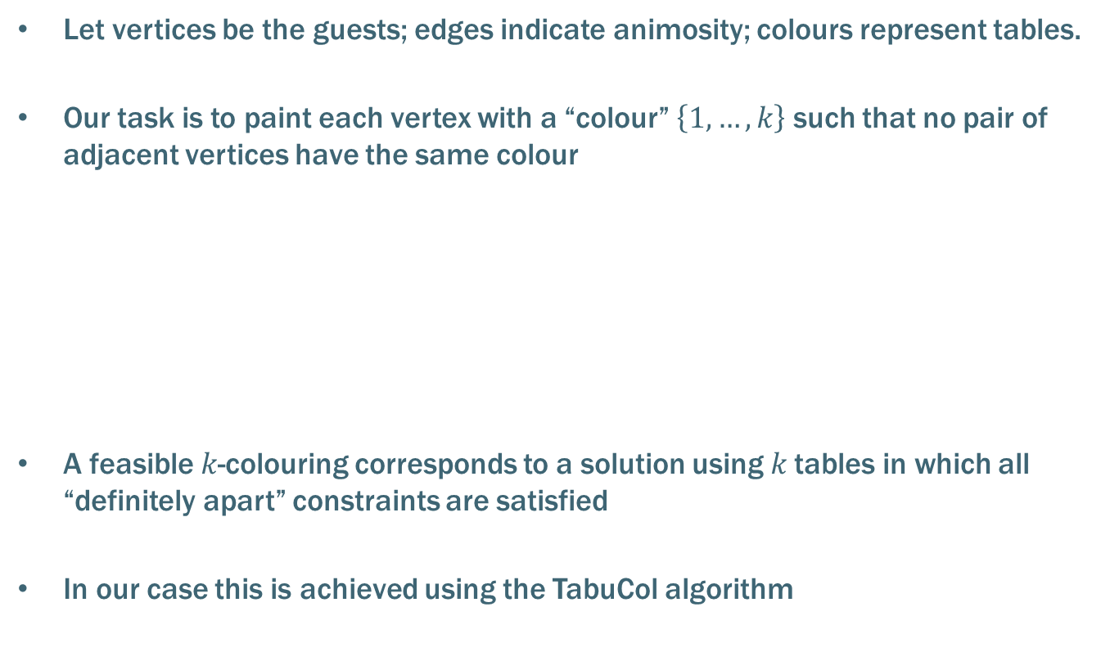
Finding a Feasible Solution
Let vertices be the guests; edges indicate animosity; colours represent tables.
Our task is to paint each vertex with a “colour” $\left\{1,…,k\right\}$ such that no pair of adjacent vertices have the same colour
A feasible $k$-colouring corresponds to a solution using $k$tables in which all “definitely apart” constraints are satisfied
In our case this is achieved using the TabuCol algorithm
1
2
1
2
Table 1 | 1, 10
Table 2 | 2, 4, 9
Table 3 | 3, 5
Table 4 | 6
Table 5 | 7, 8
3
4
5
3
4
5
6
7
8
6
7
8
9
10
9
10

Slide 18
Optimising the solution
Explore the space of feasible colourings via tabu search, attempting to
  minimise violations of the remaining constraints
  Make table sizes equal
It is important that this space features as high a connectivity as possible.
Hence the union of 2 neighbourhoods is used:
  Kempe chain interchange
  Non-adjacent swaps
Moves in both neighbourhoods will
preserve feasibility.
1
2
3
4
5
6
7
8
9
10
Eg. Kempe( , )
7

Slide 19
Optimising the solution
Explore the space of feasible colourings via tabu search, attempting to
  minimise violations of the remaining constraints
  Make table sizes equal
It is important that this space features as high a connectivity as possible.
Hence the union of 2 neighbourhoods is used:
  Kempe chain interchange
  Non-adjacent swaps
Moves in both neighbourhoods will
preserve feasibility.
1
2
3
4
5
6
7
8
9
10
Eg. Kempe( , )
7

Slide 20
Optimising the solution
Explore the space of feasible colourings via tabu search, attempting to
  minimise violations of the remaining constraints
  Make table sizes equal
It is important that this space features as high a connectivity as possible.
Hence the union of 2 neighbourhoods is used:
  Kempe chain interchange
  Non-adjacent swaps
Moves in both neighbourhoods will
preserve feasibility.
1
2
3
4
5
6
7
8
9
10
Eg. Kempe( , )
7

Slide 21
Optimising the solution
Explore the space of feasible colourings via tabu search, attempting to
  minimise violations of the remaining constraints
  Make table sizes equal
It is important that this space features as high a connectivity as possible.
Hence the union of 2 neighbourhoods is used:
  Kempe chain interchange
  Non-adjacent swaps
Moves in both neighbourhoods will
preserve feasibility.
1
2
3
4
5
6
7
8
9
10
Eg. Kempe( , )
7

Slide 22
Optimising the solution
Explore the space of feasible colourings via tabu search, attempting to
  minimise violations of the remaining constraints
  Make table sizes equal
It is important that this space features as high a connectivity as possible.
Hence the union of 2 neighbourhoods is used:
  Kempe chain interchange
  Non-adjacent swaps
Moves in both neighbourhoods will
preserve feasibility.
1
2
3
4
5
6
7
8
9
10
Eg. Kempe( , )
7

Slide 23
Optimising the solution
Explore the space of feasible colourings via tabu search, attempting to
  minimise violations of the remaining constraints
  Make table sizes equal
It is important that this space features as high a connectivity as possible.
Hence the union of 2 neighbourhoods is used:
  Kempe chain interchange
  Non-adjacent swaps
Moves in both neighbourhoods will
preserve feasibility.
1
2
3
4
5
6
7
8
9
10
Eg. Kempe( , )
7

Slide 24
Optimising the solution
Explore the space of feasible colourings via tabu search, attempting to
  minimise violations of the remaining constraints
  Make table sizes equal
It is important that this space features as high a connectivity as possible.
Hence the union of 2 neighbourhoods is used:
  Kempe chain interchange
  Non-adjacent swaps
Moves in both neighbourhoods will
preserve feasibility.
1
2
3
4
5
6
7
8
9
10
Eg. Swap( , )
10
5

Slide 25
Optimising the solution
Explore the space of feasible colourings via tabu search, attempting to
  minimise violations of the remaining constraints
  Make table sizes equal
It is important that this space features as high a connectivity as possible.
Hence the union of 2 neighbourhoods is used:
  Kempe chain interchange
  Non-adjacent swaps
Moves in both neighbourhoods will
preserve feasibility.
1
2
3
4
5
6
7
8
9
10
Eg. Swap( , )
10
5

Slide 26
Optimising the solution
Explore the space of feasible colourings via tabu search, attempting to
  minimise violations of the remaining constraints
  Make table sizes equal
It is important that this space features as high a connectivity as possible.
Hence the union of 2 neighbourhoods is used:
  Kempe chain interchange
  Non-adjacent swaps
Moves in both neighbourhoods will
preserve feasibility.
1
2
3
4
5
6
7
8
9
10
Eg. Swap( , )
10
5

Slide 27
Optimising the solution
Explore the space of feasible colourings via tabu search, attempting to
  minimise violations of the remaining constraints
  Make table sizes equal
It is important that this space features as high a connectivity as possible.
Hence the union of 2 neighbourhoods is used:
  Kempe chain interchange
  Non-adjacent swaps
Moves in both neighbourhoods will
preserve feasibility.
1
2
3
4
5
6
7
8
9
10
Eg. Swap( , )
10
5

Slide 28
Optimising the solution
Explore the space of feasible colourings via tabu search, attempting to
  minimise violations of the remaining constraints
  Make table sizes equal
It is important that this space features as high a connectivity as possible.
Hence the union of 2 neighbourhoods is used:
  Kempe chain interchange
  Non-adjacent swaps
Moves in both neighbourhoods will
preserve feasibility.
1
2
3
4
5
6
7
8
9
10
Eg. Swap( , )
10
5
Notes:
Will now show some indication of algorithm performance (use big.wpn, up to 400 guests, 50 vertices)
IP formulations were slower and not as good
1,500 p/m hits.

Slide 29


PROBLEM 3: The School Bus Routing Problem: An Analysis and Algorithm
Rhyd Lewis¹, Kate Smith-Miles² and Kyle Phillips³
¹ School of Mathematics, Cardiff University, LewisR9@cf.ac.uk.
² School of Mathematical Sciences, Monash University, kate.smith-miles@monash.edu
³ Visible Services and Transport, Vale of Glamorgan Council, kwphillips@valeofglamorgan.gov.uk

Slide 30
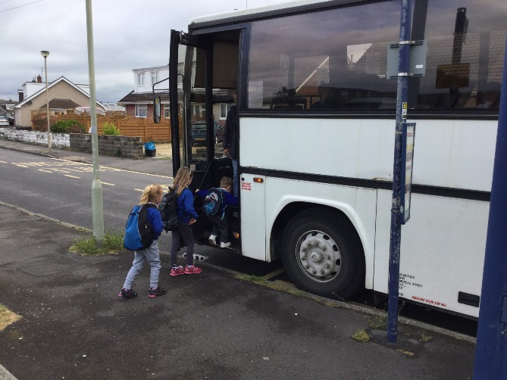
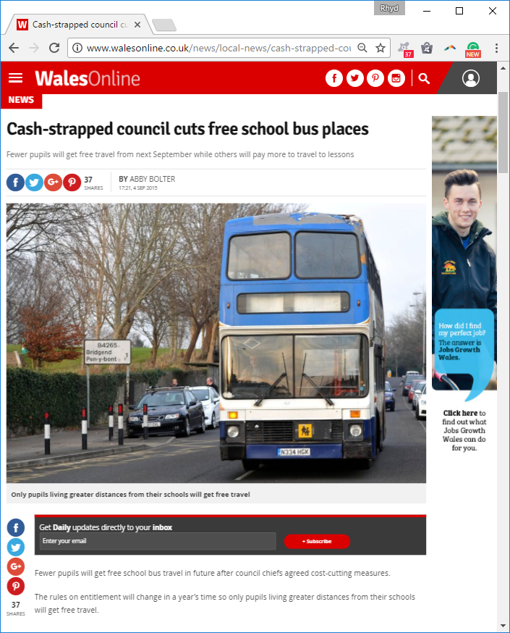
School Bus Transport
The Current Procedure…
Organised by local government
For each school a list of eligible addresses is compiled
A set of suitable bus routes are created to serve all qualifying students.
Bus companies then bid for the contracts.
Yearly contract for a 70-seat bus typically GBP£25,000 to £35,000,
Costs can increase for longer journeys and for routes requiring a chaperone
Notes:
Government “austerity” has led to cuts at local government level.

Slide 31


Problem Description
Constraints…
Bus journeys should not be too long (<45 mins)
Stops should within walking distance from home (<1 mile)
Features…
Minimise the number of buses / routes
Use a subset of stops
Multi-stops are permitted
Boarding the bus takes time
Bus Stop
Address
Notes:
Bipartite graph. No singleton vertices.
These limits can be different for older children. They are “guidelines”

Slide 32
Problem Description
Constraints…
Bus journeys should not be too long (<45 mins)
Stops should within walking distance from home (<1 mile)
Features…
Minimise the number of buses / routes
Use a subset of stops
Multi-stops are permitted
Boarding the bus takes time
Bus Stop
Address
Notes:
Not just “yet another VRP” (Open VRP, time capacitated, split delivery)
Selection of stops gives extra layer of complexity. Indeed stop selection is usually omitted in the VRP literature
Can have 2 buses following the same route
Dwell times
Packing problem

Slide 33
Problem Description
A Feasible Solution…
All addresses must have a serviced bus stop within walking distance
Journeys do not exceed the maximum time limit
Number of students boarding does not exceed maximum bus capacity
Bus Stop
Address
Notes:
Now show ACTUAL SOLUTION using my visualizer

Slide 34
Allocating students to routes/buses
Stop 1, 50 students
Students are allocated to the closest stops being used
This results in a relaxed bin packing problem.
Splitting an “item” results in a multi-stop
Stop 2, 30 students
Stop 3, 20 students
Stop 4, 10 students
1
1
2
3
1
4
4
2
3
Stop 1 Stop 2 Stop 3 Stop 4
Bus 1
Bus 2
Bus 3
(Bus Capacity = 40)
Notes:
If multi-stops were not allowed, we would have the NP-complete bin packing problem (because we could not split items)
Here, we can split items, though avoiding multi-stops makes sense (less stops per route)

Slide 35
Selecting the subset of stops
Let S be the set whose elements correspond to the addresses within walking distance of each bus stop:
All addresses in a feasible solution must be served by a bus stop;
Hence the task of choosing a suitable subset of stops is a set covering problem using S and the set of stops.
Bus Stop
Address

Slide 36
Selecting the subset of stops
Let S be the set whose elements correspond to the addresses within walking distance of each bus stop:
All addresses in a feasible solution must be served by a bus stop;
Hence the task of choosing a suitable subset of stops is a set covering problem using S and the set of stops.
Theorem
Assuming
the triangle inequality, and
multistops are not permitted,
the optimal solution corresponds to a minimal set covering
Bus Stop
Address
Notes:
Note, a minimal covering, not a MINIMUM covering, which is NP-hard.
Proof in the paper

Slide 37
Algorithm Strategy
Only consider feasible solutions, but allow long routes.
Then seek to shorten the routes to below the required time limit
For a fixed number of vehicles k…
Create a minimal covering of stops, assign all passengers to stops, and all stops to vehicles.
Use a local search operator to shorten the resultant routes.
Use the current solution to determine a new minimal covering of stops and repair solution.
Return to 2),
OR increase k and return to 1)
Local Optimum
Other Solution
Notes:
We start k at the lower bound of number of passengers / vehicle capacity.
K is increased after a time limit.
Alternative approach to use k as part of the cost. But found it is too discrete for this.
ILS is basically a random walk around a local optima graph, though it needn’t be.

Slide 38
Local Search Operators
Inter-route Operators
R₁ =
u₁ | u₂ | u₃ | u₄ | u₅ | u₆ | u₇
R₁ =
u₁ | u₂ | v₂ | v₃ | u₆ | u₇
Section Swap
R₂ =
v₁ | v₂ | v₃ | v₄ | v₅ | v₆
R₂ =
v₁ | u₅ | u₄ | u₃ | v₄ | v₅ | v₆
R₁ =
u₁ | u₂ | u₃ | u₄ | u₅ | u₆ | u₇
R₁ =
u₁ | u₂ | u₆ | u₇
Section Insert
R₂ =
v₁ | v₂ | v₃ | v₄ | v₅ | v₆
R₂ =
v₁ | u₅ | u₄ | u₃ | v₂ | v₃ | v₄ | v₅ | v₆
Intra-route Operators
R =
u₁ | u₂ | u₃ | u₄ | u₅ | u₆ | u₇
R =
u₁ | u₅ | u₆ | u₂ | u₃ | u₄ | u₇
Extended Or-Opt
+ 2-opt and swaps
Notes:
Inversions are permitted in the operators.
Intra-route operators could result in buses being overfilled, so are not performed
Multi-stops within the same route are not permitted
All operators can be evaluated in constant time. O(n^4) neighbours
Intra-route operators do not affect assignments to stops/buses, etc.

Slide 39
Generating a new minimal subset of stops
Take a small number of non-compulsory serviced stops and deselect them.
Add new stops to ensure all passengers are served. (Ensuring the subset is still minimal).
Repair the routes and passenger allocations to reflect the changes
Bus Stop
Address

Slide 40
Generating a new minimal subset of stops
Take a small number of non-compulsory serviced stops and deselect them.
Add new stops to ensure all passengers are served. (Ensuring the subset is still minimal).
Repair the routes and passenger allocations to reflect the changes
Bus Stop
Address

Slide 41
Generating a new minimal subset of stops
Take a small number of non-compulsory serviced stops and deselect them.
Add new stops to ensure all passengers are served. (Ensuring the subset is still minimal).
Repair the routes and passenger allocations to reflect the changes
Bus Stop
Address

Slide 42
Generating a new minimal subset of stops
Take a small number of non-compulsory serviced stops and deselect them.
Add new stops to ensure all passengers are served. (Ensuring the subset is still minimal).
Repair the routes and passenger allocations to reflect the changes
Bus Stop
Address

Slide 43
Generating a new minimal subset of stops
Take a small number of non-compulsory serviced stops and deselect them.
Add new stops to ensure all passengers are served. (Ensuring the subset is still minimal).
Repair the routes and passenger allocations to reflect the changes
Bus Stop
Address

Slide 44
Random Instance Generation
Put a school at the centre of a circle…
Add stops anywhere in the circle
Now add addresses that are
  Within walking distance of a stop
  Not too close to the school.
Finally, remove any stops with no address within waking distance
Bus Stop
Address
Notes:
Small maximum walking distance gives addresses that are clustered around stops.
In extreme cases, all stops will be required. (No stop selection element)

Slide 45
Random Instance Generation
Put a school at the centre of a circle…
Add stops anywhere in the circle
Now add addresses that are
  Within walking distance of a stop
  Not too close to the school.
Finally, remove any stops with no address within waking distance
Bus Stop
Address
Notes:
In contrast, the above is generated with larger walks being permitted.

Slide 46
Results with Random Graphs
25 stops
50 stops
100 stops
250 stops
Maximum walking
distance (miles)
Maximum drive
time (mins)
Extra vehicles (routes) required for random graphs with 1,000 students using 70-seat buses. All instances used a 15-mile radius circle, with buses travelling along straight lines at 30mph; hence, all bus stops are within 30 minutes of the school.
Notes:
Ten seconds of execution time permitted for each value of k.
More routes are needed when both the maximum journey times and the maximum walking distances are low.
Shorter journey limits imply the need for more routes in feasible solutions.
Short walk limits means addresses are tightly clustered around bus stops; consequently, nearly all bus stops will be compulsory, meaning that any savings that could be achieved by only using a subset of the bus stops are not available, creating a need for additional routes.
Multistops occur more frequently when it is advantageous or necessary to assign large numbers of students to individual bus stops. (where students are able to walk larger, or where the number of bus stops is small)

Slide 47
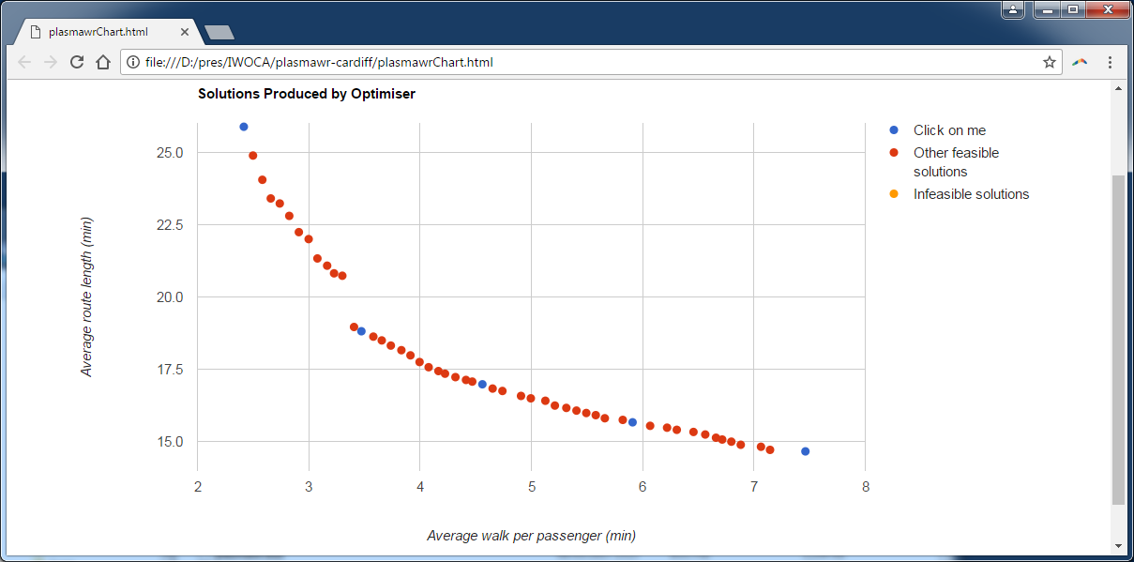
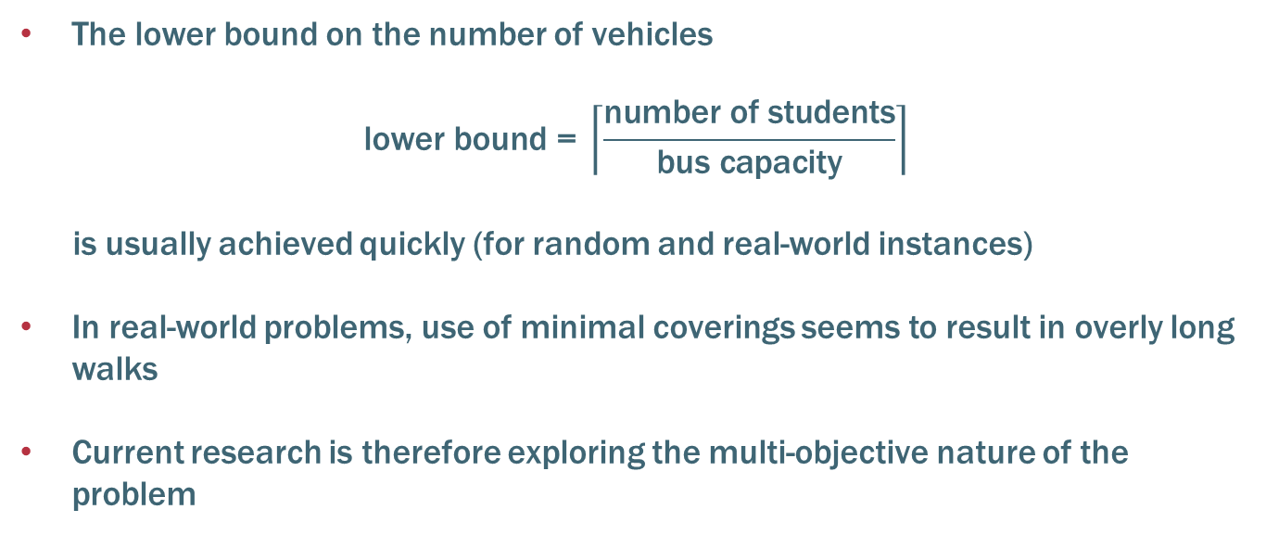
Conclusions and Ongoing Research
The lower bound on the number of vehicles
$$\text{lower} \text{bound}\text{ = }\left\lceil \frac{\text{number} \text{of} \text{students}}{\text{bus} \text{capacity}}\right\rceil$$
is usually achieved quickly (for random and real-world instances)
In real-world problems, use of minimal coverings seems to result in overly long walks
Current research is therefore exploring the multi-objective nature of the problem
Notes:
This is particularly so for instances where only a small proportion of bus stops need to be used.
Currently using this same method with large real-world problems generated using web mapping services.
DOUBLE TRIPPING
GO ON TO SHOW MULTI-OBJ STUFF

Slide 48
Three real-world operational research problems and their underlying graph properties.
Rhyd Lewis
School of Mathematics, Cardiff University, LewisR9@cf.ac.uk.
www.RhydLewis.eu
Notes:
In this talk I will introduce three original and real-world combinatorial optimisation problems, together with algorithms that exploit their underlying graph-theoretic properties. The first problem makes use of Eulerian cycles to help arrange trapezoids into sequences so that the space between successive shapes in minimised. The second problem concerns the design of seating plans for large parties, using ideas from the graph colouring problem. Finally, the third problem uses notions from vehicle routing, set covering, and bin packing to help produce cost effective school transport systems.

