Slide 1
An Introduction to Petri Nets
By
Chris Ling

Slide 2
Introduction
First introduced by Carl Adam Petri in 1962.
A diagrammatic tool to model concurrency and synchronization in distributed systems.
Used as a visual communication aid to model the system behaviour.
Based on strong mathematical foundation.

Slide 3
Example: EFTPOS System (FSM)
Initial
1 digit
d1
1 digit
d2
1 digit
d3
1 digit
d4
OK
OK
OK
OK
OK
OK
pressed
Rejected
Reject
approve
Initial state
Approved
Final state

Slide 4
Example: EFTPOS System (A Petri net)
1 digit
1 digit
1 digit
1 digit
d4
Initial
d1
d2
d3
OK
OK
OK
OK
OK
OK
pressed
Rejected!
Reject
approve
approved

Slide 5
EFTPOS Systems
Scenario 1: Normal
Scenario 2: Exceptional (Enters only 3 digits)

Slide 6
Example: EFTPOS System (Token Games)
1 digit
1 digit
1 digit
1 digit
d4
Initial
d1
d2
d3
OK
OK
OK
OK
OK
OK
pressed
Rejected!
Reject
approve
approved

Slide 7
A Petri Net Specification ...
consists of three types of components: places (circles), transitions (rectangles) and arcs (arrows):
Places represent possible states of the system;
Transitions are events or actions which cause the change of state; And
Every arc simply connects a place with a transition or a transition with a place.

Slide 8
A Change of State …
is a movement of token(s) (black dots) from place(s) to place(s); and is caused by the firing of a transition.
The firing represents an occurrence of the event.
The firing is subject to the input conditions, denoted by the tokens available.

Slide 9
A Change of State
A transition is firable or enabled when there are sufficient tokens in its input place.
After firing, tokens will be transferred from the input places (old state) to the output places, denoting the new state.

Slide 10
Example: Vending Machine
The machine dispenses two kinds of snack bars – 20c and 15c.
Only two types of coins can be used – 10c coins and 5c coins.
The machine does not return any change.

Slide 11
Example: Vending Machine (Finite State Machine)
Take 15c snack bar
5 cents
Deposit 10c
15 cents
Deposit 5c
0 cent
Deposit 5c
Deposit 5c
Deposit 5c
Deposit 10c
10 cents
Deposit 10c
20 cents
Take 20c snack bar

Slide 12
Example: Vending Machine (A Petri net)
Take 15c bar
Deposit 10c
15c
5c
Deposit 5c
Deposit 5c
Deposit
5c
0c
Deposit
5c
Deposit 10c
10c
20c
Deposit 10c
Take 20c bar

Slide 13
Example: Vending Machine (3 Scenarios)
Scenario 1:
Deposit 5c, deposit 5c, deposit 5c, deposit 5c, take 20c snack bar.
Scenario 2:
Deposit 10c, deposit 5c, take 15c snack bar.
Scenario 3:
Deposit 5c, deposit 10c, deposit 5c, take 20c snack bar.

Slide 14
Example: Vending Machine (Token Games)
Take 15c bar
Deposit 10c
15c
5c
Deposit 5c
Deposit 5c
Deposit
5c
0c
Deposit
5c
Deposit 10c
10c
20c
Deposit 10c
Take 20c bar

Slide 15
Example: In a Restaurant (A Petri Net)
Waiter
free
Customer 1
Customer 2
Take
order
Take
order
wait
Order
taken
wait
eating
eating
Tell
kitchen
Serve food
Serve food

Slide 16
Example: In a Restaurant (Two Scenarios)
Scenario 1:
Waiter takes order from customer 1; serves customer 1; takes order from customer 2; serves customer 2.
Scenario 2:
Waiter takes order from customer 1; takes order from customer 2; serves customer 2; serves customer 1.

Slide 17
Example: In a Restaurant (Scenario 1)
Waiter
free
Customer 1
Customer 2
Take
order
Take
order
wait
Order
taken
wait
eating
eating
Tell
kitchen
Serve food
Serve food

Slide 18
Example: In a Restaurant (Scenario 2)
Waiter
free
Customer 1
Customer 2
Take
order
Take
order
wait
Order
taken
wait
eating
eating
Tell
kitchen
Serve food
Serve food

Slide 19
What is a Petri Net Structure
A directed, weighted, bipartite graph G = (V,E)
Nodes (V)
places (shown as circles)
transitions (shown as bars)
Arcs (E)
from a place to a transition or from a transition to a place
labelled with a weight (a positive integer, omitted if it is 1)

Slide 20
Marking
Marking (M)
An m-vector (k0,k1,…,km)
m: the number of places
ki >= 0: the number of “tokens” in place pi

Slide 21
A marking is a state ...
t8
p4
M0 = (1,0,0,0,0)
t4
p2
M1 = (0,1,0,0,0)
t1
M2 = (0,0,1,0,0)
M3 = (0,0,0,1,0)
p1
M4 = (0,0,0,0,1)
t3
t5
t7
Initial marking:M0
t6
p5
t2
p3
t9

Slide 22
Another Example
A producer-consumer system, consist of one producer, two consumers and one storage buffer with the following conditions:
The storage buffer may contain at most 5 items;
The producer sends 3 items in each production;
At most one consumer is able to access the storage buffer at one time;
Each consumer removes two items when accessing the storage buffer

Slide 23
A Producer-Consumer Example
In this Petri net, every place has a capacity and every arc has a weight.
This allows multiple tokens to reside in a place.

Slide 24
A Producer-Consumer System
k=1
k=2
ready
accepted
p1
p4
Buffer p3
produce
accept
3
2
t1
t2
t3
t4
consume
send
k=5
p2
p5
idle
ready
k=1
k=2
Producer
Consumers

Slide 25
A Producer-Consumer System
k=1
k=2
ready
accepted
p1
p4
Buffer p3
produce
accept
3
2
t1
t2
t3
t4
consume
send
k=5
p2
p5
idle
ready
k=1
k=2
Producer
Consumers

Slide 26
A Producer-Consumer System
k=1
k=2
ready
accepted
p1
p4
Buffer p3
produce
accept
3
2
t1
t2
t3
t4
consume
send
k=5
p2
p5
idle
ready
k=1
k=2
Producer
Consumers

Slide 27
A Producer-Consumer System
k=1
k=2
ready
accepted
p1
p4
Buffer p3
produce
accept
3
2
t1
t2
t3
t4
consume
send
k=5
p2
p5
idle
ready
k=1
k=2
Producer
Consumers

Slide 28
A Producer-Consumer System
k=1
k=2
ready
accepted
p1
p4
Buffer p3
produce
accept
3
2
t1
t2
t3
t4
consume
send
k=5
p2
p5
idle
ready
k=1
k=2
Producer
Consumers

Slide 29
A Producer-Consumer System
k=1
k=2
ready
accepted
p1
p4
Buffer p3
produce
accept
3
2
t1
t2
t3
t4
consume
send
k=5
p2
p5
idle
ready
k=1
k=2
Producer
Consumers

Slide 30
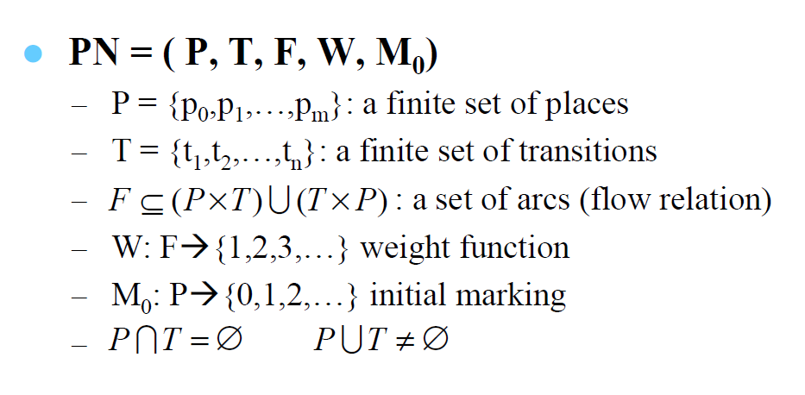
Formal Definition of Petri Net
N = (P, T, F, W) is a Petri net structure
A Petri net with the given initial marking is denoted by (N, M₀ )

Slide 31
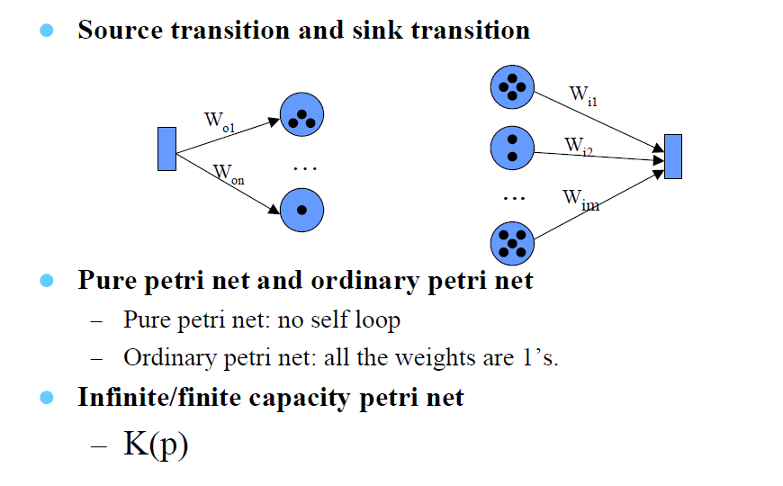
Formal Definition of Petri Net

Slide 32
Inhibitor Arc
Elevator Button (Figure 10.21)
Press
Button
Elevator in
action
Button Pressed
At Floor f
At Floor g

Slide 33
Net Structures
A sequence of events/actions:
Concurrent executions:
e1
e2
e3
e2
e3
e1
e4
e5

Slide 34
Net Structures
Non-deterministic events - conflict, choice or decision: A choice of either e1 or e3.
e1
e2
e3
e4

Slide 35
Net Structures
Synchronization
e1

Slide 36
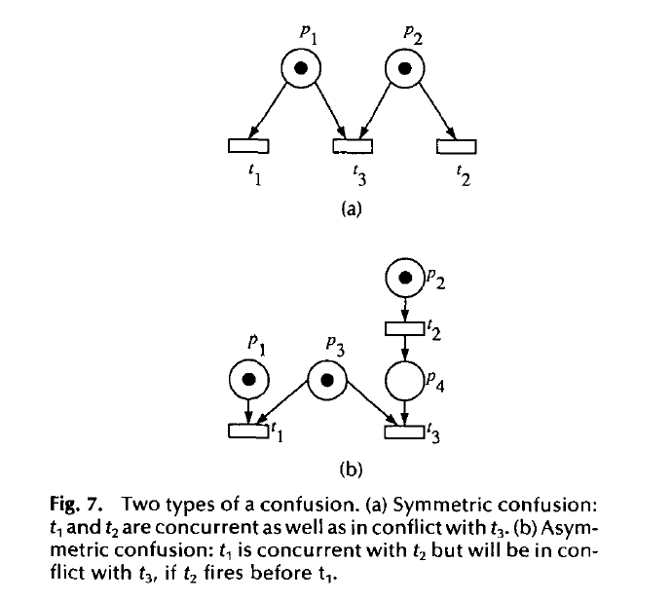
Net Struture – Confusion
Murata (1989)

Slide 37
Modelling Examples
Finite State Machines
Parallel Activities
Dataflow Computation
Communication Protocols
Synchronisation Control
Producer Consumer Systems
Multiprocessor Systems

Slide 38
Properties
Behavioural properties
Properties hold given an initial marking
Structural properties
Independent of initial markings
Relies on the topology of the net structure.

Slide 39
Behavioural Properties
Reachability
Boundedness
Liveness
Reversibility
Coverability
Etc....

Slide 40
Reachability
t8
p4
t4
M0 = (1,0,0,0,0)
p2
t1
M1 = (0,1,0,0,0)
M2 = (0,0,1,0,0)
p1
M3 = (0,0,0,1,0)
t3
t5
t7
M4 = (0,0,0,0,1)
p3
t6
p5
Initial marking:M0
t2
t9
M0
t1
t3
t5
t8
t2
t6
M1
M2
M3
M0
M2
M4

Slide 41
Reachability
A firing or occurrence sequence:
M0
t1
t3
t5
t8
t2
t6
M1
M2
M3
M0
M2
M4
“M2 is reachable from M1 and M4 is reachable from M0.”
In fact, in the vending machine example, all markings are reachable from every marking.

Slide 42
Reachability
Reachability or Coverability Tree
M0
t1
t2
t9
t8
t3
M1
M2
t4
t5
t6
t7
M3
M4

Slide 43
Boundedness
A Petri net is said to be k-bounded or simply bounded if the number of tokens in each place does not exceed a finite number k for any marking reachable from M0.
The Petri net for vending machine is 1-bounded and the Petri net for the producer-consumer system is not bounded.
A 1-bounded Petri net is also safe.

Slide 44
Liveness
A Petri net with initial marking M0 is live if, no matter what marking has been reached from M0, it is possible to ultimately fire any transition by progressing through some further firing sequence.
A live Petri net guarantees deadlock-free operation, no matter what firing sequence is chosen.

Slide 45
Liveness
The vending machine is live and the producer-consumer system is also live.
A transition is dead if it can never be fired in any firing sequence.

Slide 46
An Example
t1
p3
p1
p2
t3
t4
p4
t2
M0 = (1,0,0,1)
M1 = (0,1,0,1)
M2 = (0,0,1,0)
M3 = (0,0,0,1)
A bounded but non-live Petri net

Slide 47
Another Example
p1
M0 = (1, 0, 0, 0, 0)
M1 = (0, 1, 1, 0, 0)
t1
M2 = (0, 0, 0, 1, 1)
M3 = (1, 1, 0, 0, 0)
p2
p3
M4 = (0, 2, 1, 0, 0)
t2
t3
p4
p5
t4
An unbounded but live Petri net

Slide 48
Structural Properties
Structurally live
There exists a live initial marking for N
Controllability
Any marking is reachable for any other marking
Structural Boundedness
Bounded for any finite initial marking
Conservativeness
Total number of tokens in the net is a constant

Slide 49
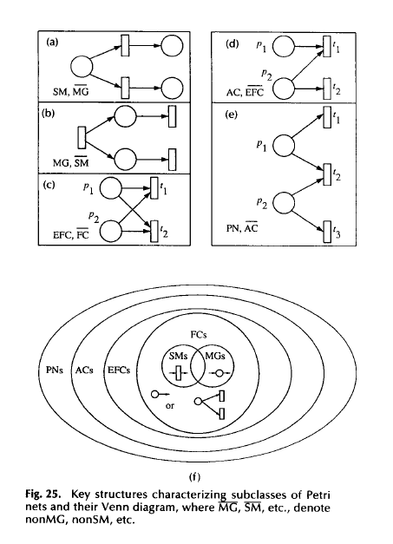
Net Structures
Subclasses of Petri Nets (PN):
State Machine (SM)
Marked Graph (MG)
Free Choice (FC)
Extended Free Choice (EFC)
Asymmetric Choice (AC)

Slide 50
Analysis Methods
Reachability Analysis:
Reachability or coverability tree.
State explosion problem.
Incidence Matrix and State Equations.
Structural Analysis
Based on net structures.

Slide 51
Analysis Methods
Reduction Rules:
reduce the model to a simpler one. For example:

Slide 52
Other Types of Petri Nets
High-level Petri nets
Tokens have “colours”, holding complex information.
Timed Petri nets
Time delays associated with transitions and/or places.
Fixed delays or interval delays.
Stochastic Petri nets: exponentially distributed random variables as delays.

Slide 53
Other Types of Petri Nets
Object-Oriented Petri nets
Tokens are instances of classes, moving from one place to another, calling methods and changing attributes.
Net structure models the inner behaviour of objects.
The purpose is to use object-oriented constructs to structure and build the system.

Slide 54
My Thesis
Title: Petri net modelling and analysis of real-time systems based on net structure [manuscript] / by Sea Ling (1998)
Monash University. Thesis. Monash University. School of Computer Science and Software Engineering.
Publication notes: Thesis (Ph.D.)--Monash University, 1998.

Slide 55
Other works
Business processes and workflows
Wil van der Aalst
Petri net markup language (PNML)
Agent technology
SOA and Web services
Grid

Slide 56
References
Murata, T. (1989, April). Petri nets: properties, analysis and applications. Proceedings of the IEEE, 77(4), 541-80.
Peterson, J.L. (1981). Petri Net Theory and the Modeling of Systems. Prentice-Hall.
Reisig, W and G. Rozenberg (eds) (1998). Lectures on Petri Nets 1: Basic Models. Springer-Verlag.
The World of Petri nets: http://www.daimi.au.dk/PetriNets/

